Slide 1
Group Mogic

Slide 2
What have we done
Wrote documents and wikis.
Finished the code of Server.
Done some simple tests.
Built a simulated Light, Database, Controller and Web Page to test the all functions.
Done some performance tests.

Slide 3
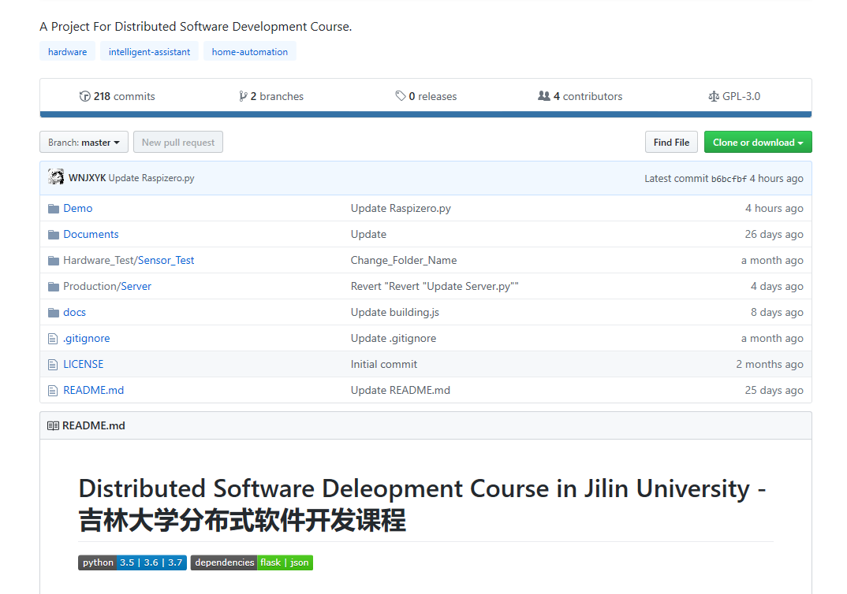
Two branches: master & production.
218 commits.
4 Wiki pages.

Slide 4
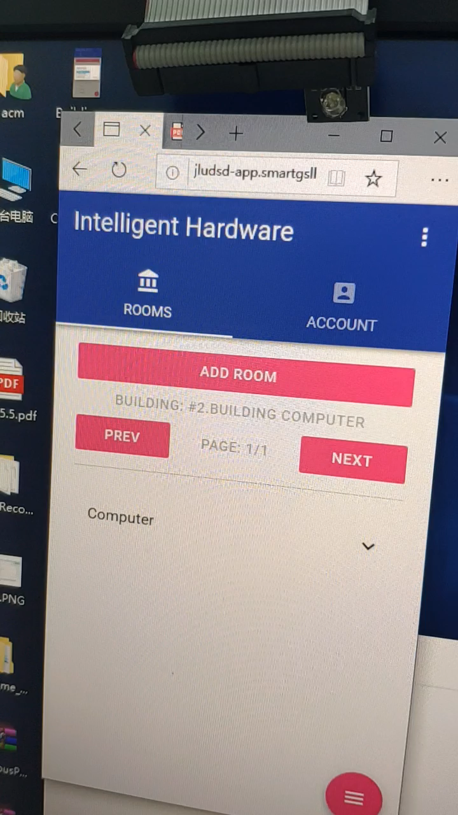
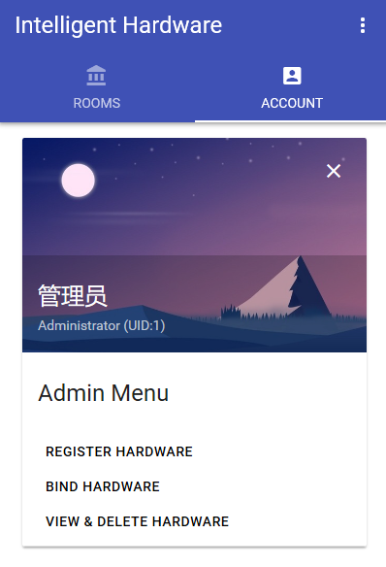
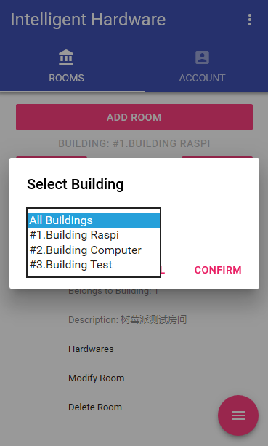
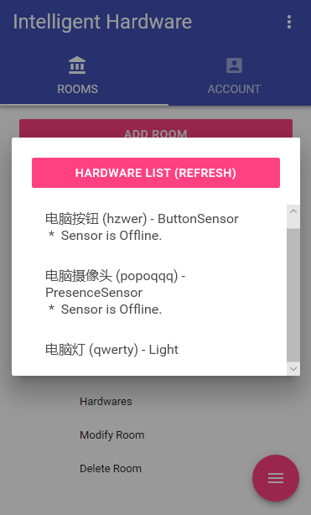
Simulated Integrated test
Add & Del Hardware
Add & Del Rooms
Modify Rooms
Login & Admin Functions
Select Buildings & Rooms
View & Control

Slide 5
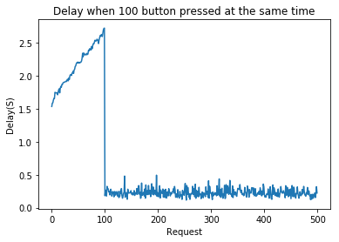
Test the performance of Server
VPS in China (Ping : 100+ms)
100 Buttons & 100 Lights in 100 Rooms
Result : After all sensors and lights have built connections with server, the delay of turning on/off is under 0.5s.

Slide 6
Now, we are doing real integrated tests with other groups.

